Slide 1


Slide 2
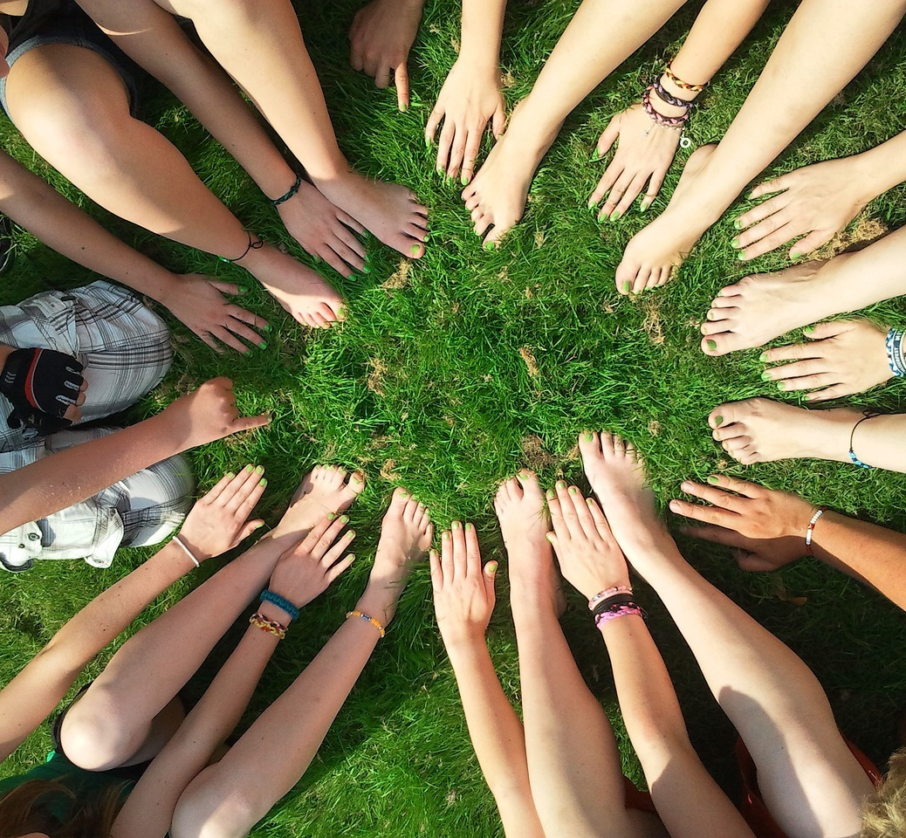
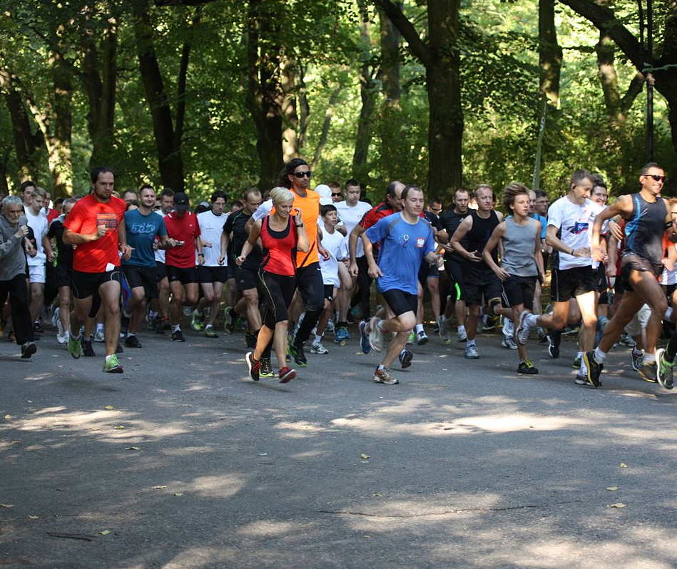
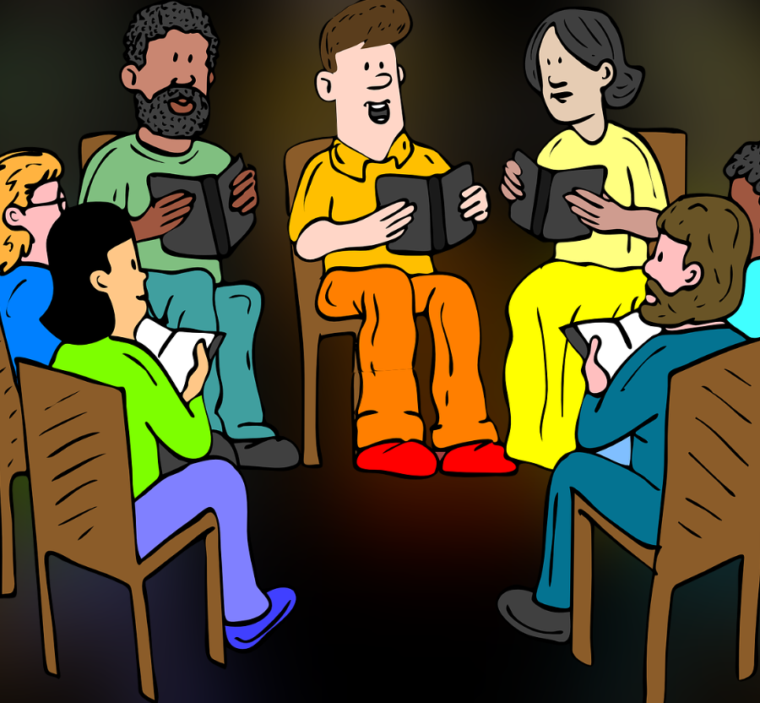
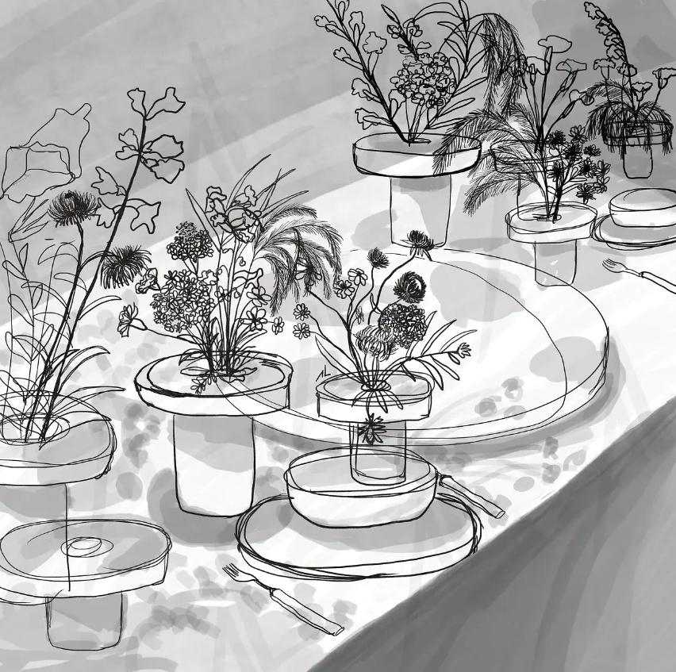
events
DATE: OCT 31
TIME: 8:00 AM
TITLE: LANDCARE
DATE: SEPT 14
TIME: 9:00 AM
TITLE: PARKRUN
DATE: SEPT 17
TIME: 6:00 PM
TITLE: BOOKCLUB
DATE: OCT 24-31
TIME: 12:00 AM
TITLE: DRAWTOBER

Slide 3

check in
I feel accepted in this group

Slide 4
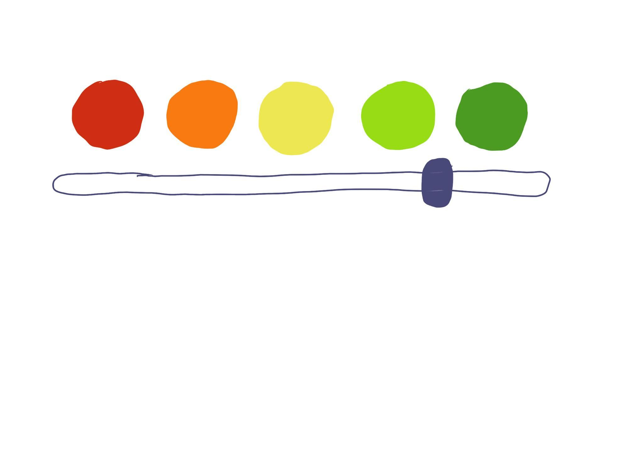
register
How often do you feel lonely?

Slide 5

connect

Slide 6

connect

